Slide 1
Resonant x-ray reflectivity: probing the chemical and magnetic profiles of samples
Thomas Hase
University of Warwick, UK
3rd ORSO Meeting 2021

Slide 2
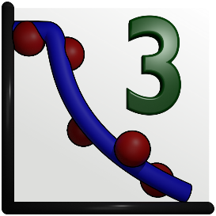








Acknowledgments
Gavin Bell, Stephanie Glover, Matthew Brewer, Rachel Procter, Björgvin Hjörvarsson, Fridrik Magnus, Vassilios Kapaklis, Unnar Arnalds, Del Atkinson, Oto-obong Inyang, Charles Swindells, Richard Rowan-Robinson, Matts Björck and many others.
Beamline Staff across:
XMaS, PolRef, CRISP, 4-ID-D@APS, X13A@NSLS, 1.1 and 5U1 @ Daresbury and many other synchrotron and neutron facility colleagues.

Slide 3
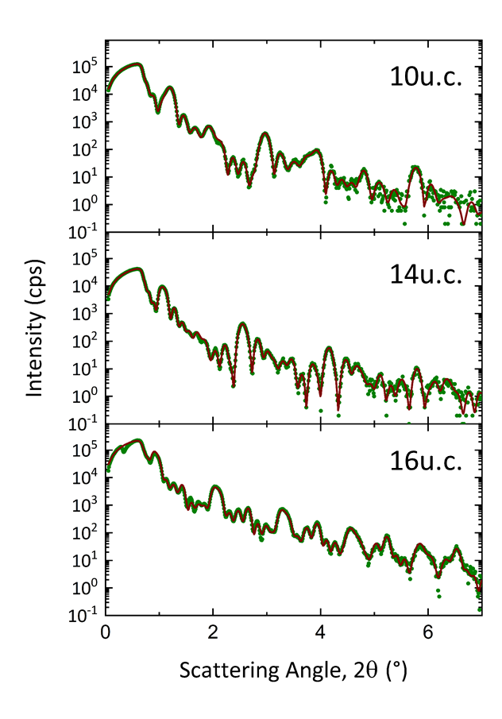
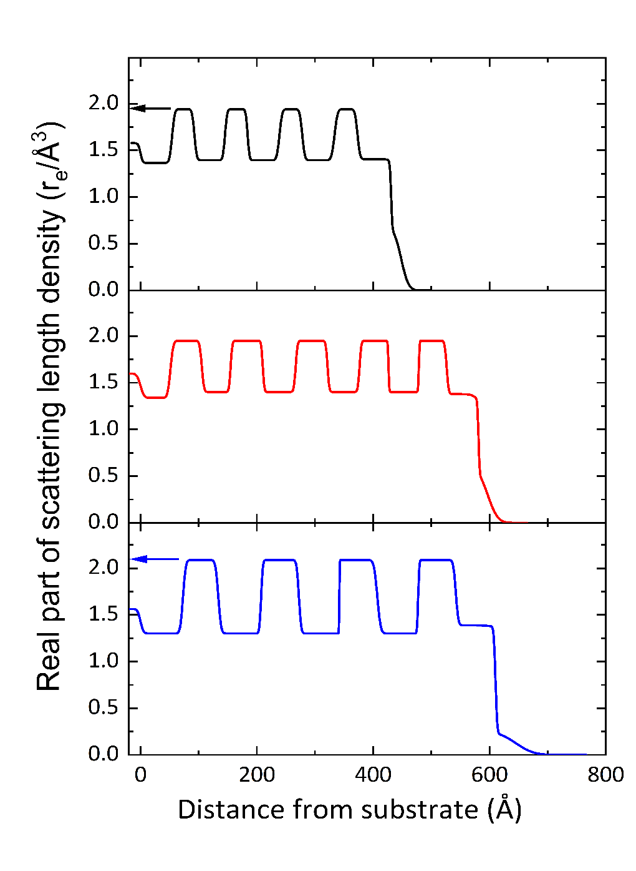
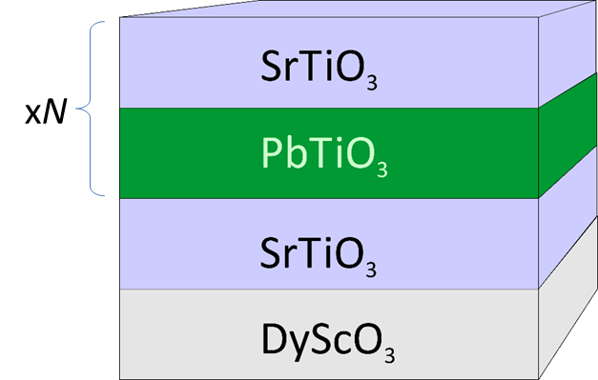
X-ray Reflectometry: Health Warning
Claimed Information obtained:
Number and repetition of layers
Layer thickness
Layer density/composition
Interface width
What we actually refine is the SLD which has systematic bias in it due to the input model used.

Slide 4
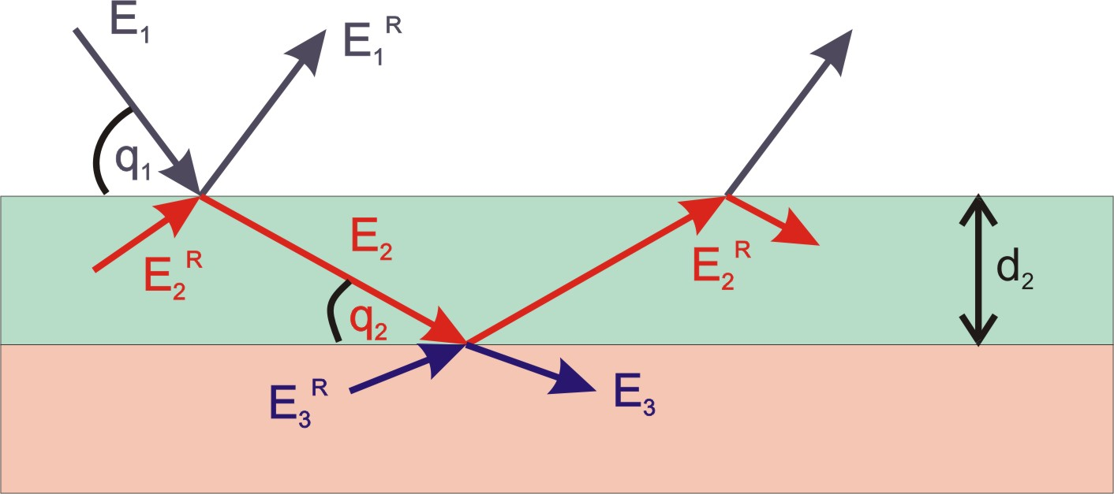
X-ray Reflectometry: Model Inputs
In most packages, samples are defined using slabs of material which is defined by their refractive index, n=1-δ-iβ, and recursive methods used to determine the electric field and hence the reflected intensity.
The refractive index, and hence the SLD is therefore a product of the density and the scattering factors (composition).

Slide 5
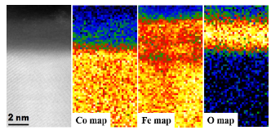

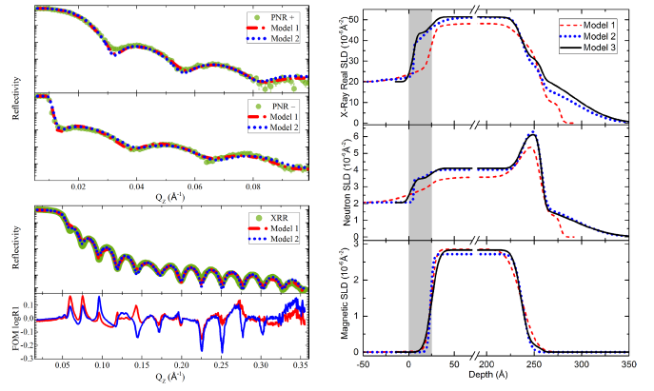
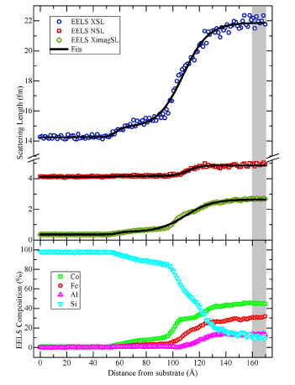
Combined XRR and PNR
One way to attempt to separate density from composition is to use both XRR and PNR and perform a simultaneous fit – here applied to the Heusler alloy Co₂FeAl_{0.5}Si_{0.5} epitaxial films on Si(1 1 1). But still problems in getting unique fits.
S E Glover et al. J. Phys.: Condens. Matter 30 065801 (2018)

Slide 6
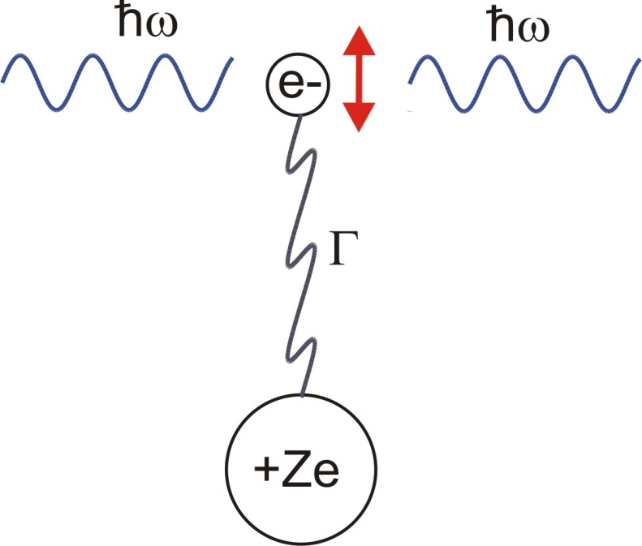
Anomalous Dispersion
For x-rays the EM wave couples to the electrons in the atom so the atomic scattering factor is the Fourier transform of the electron density.
Due to the absorption edges, the system is more like a driven oscillator, as the electrons are not free:
These terms are the energy dependent anomalous scattering factors which depend on energy and are used in resonant reflectivity (scattering).

Slide 7
Resonant Scattering
Tuning the incident energy close to an absorption edge of an element changes the refractive index of any layer containing that element (f’ and f’’) and provides an element specific contrast enhancement and a possible route towards separating concentration and physical density.
https://henke.lbl.gov/optical_constants/asf.html

Slide 8
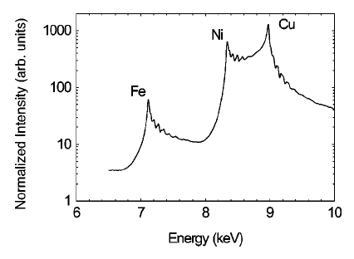
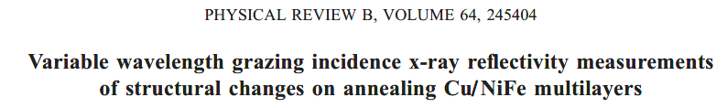
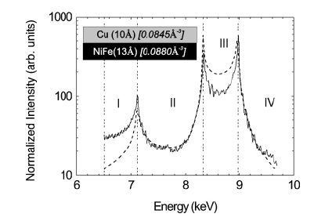
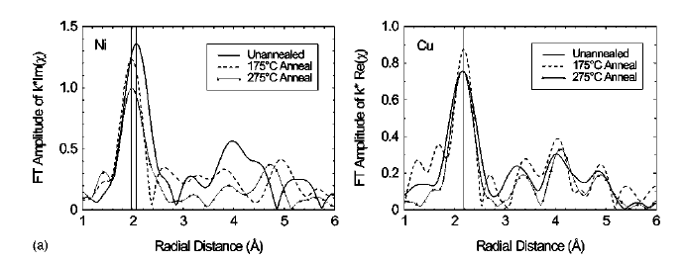
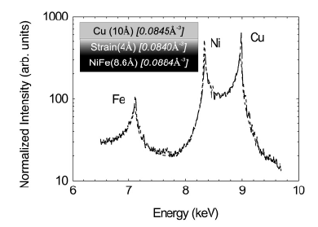
Variable Energy Reflectivity
Variable energy analysis allows density to separated from composition by combining the Q dependence of the XRR with the spectroscopy. Here we follow the Bragg Peak as a function of energy and assume the tabulated x-ray scattering factors are accurate.
Bragg Peak Intensity:
G. M. Luo et al. Phys. Rev. B 64 245404 (2001)

Slide 9
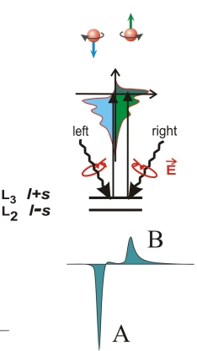
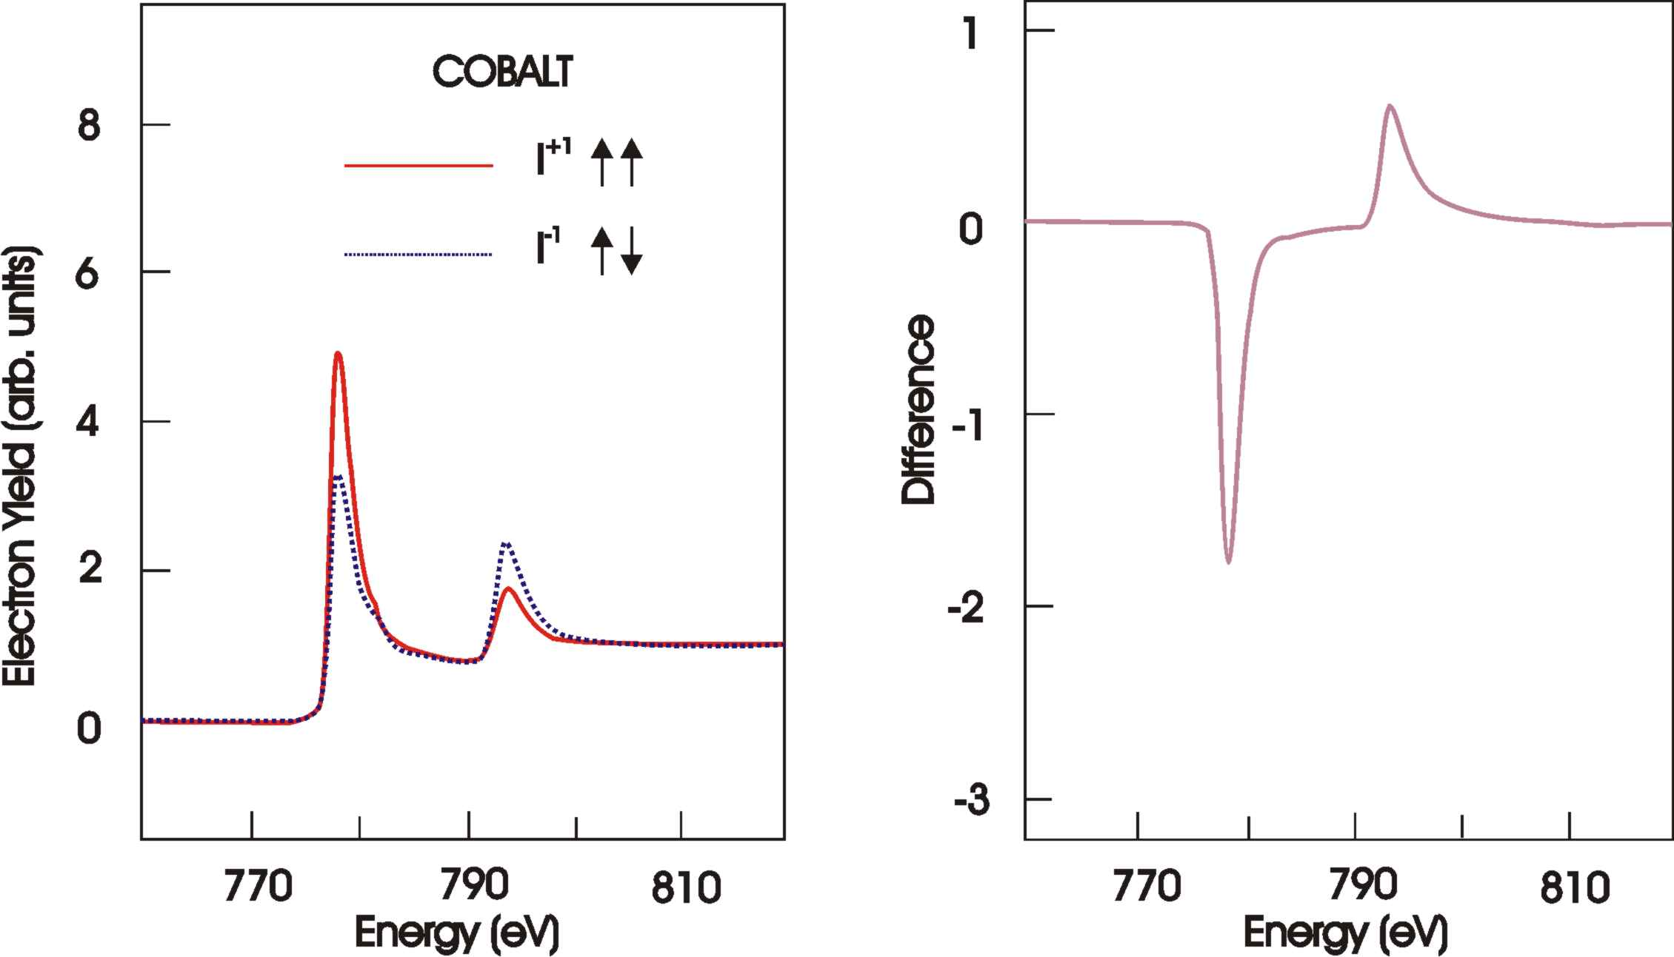
Not all absorption edges are equal!
Dipole transitions which probe the spin split Fermi energy have transition probabilities (absorption) which depend on the magnetic moment (XMCD).
At the Co L₃ edge, electrons are preferentially selected from core levels and the spin-split d-states at the Fermi energy act as a spin filter in the cross-section. The transition probability is thus sensitive to the sum and orbital parts of the magnetisation (XMCD sum rules).

Slide 10
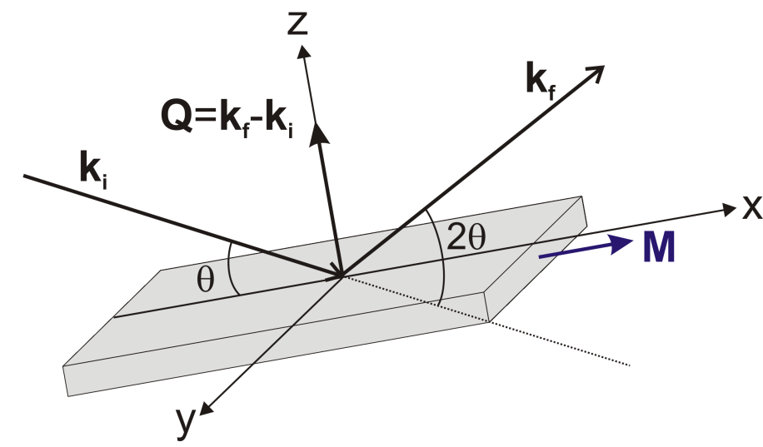
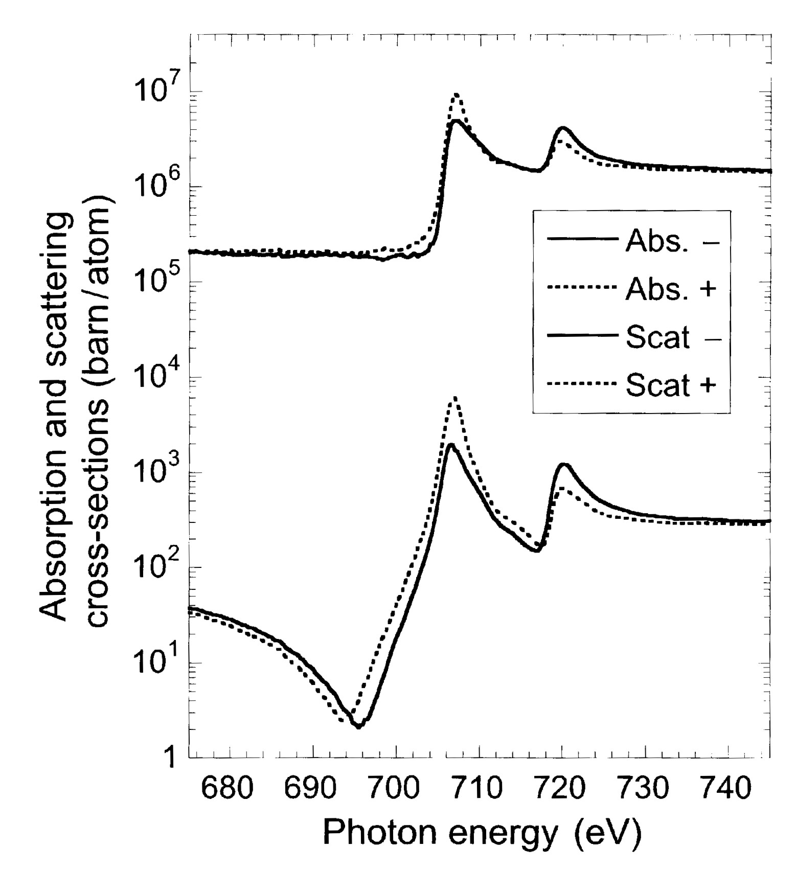
Scattering amplitude
Fe
In a scattering geometry both the real and imaginary parts of the cross-section are important.
On “magnetic resonances” we have the usual anomalous terms as well as an additional term related to the magnetisation and helicity.
At soft energies (< 1 keV), experimental constraints makes performing reflectivity more difficult requiring UHV.
J. Stöhr and H.C. Siegmann “Magnetism: From Fundamentals to Nanoscale Dynamics” Springer Series in Solid-State Sciences (2006)

Slide 11
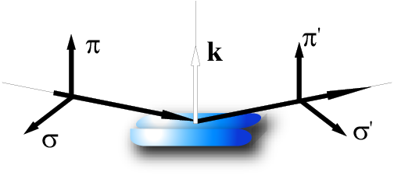
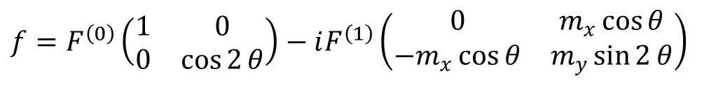
Polarization Dependence
Using circular polarisation (ignoring linear polarisation) and assuming in-plane magnetisation simplifies the scattering factors:
q
Reformulate the scattering vector into a 2x2 matrix with the polarization being either parallel (σ) or perpendicular (π) to the scattering plane:
$$f=F^{\left(0\right)}\left(\begin{matrix}1 & 0 \\ 0 & \cos{2}θ\end{matrix}\right)−iF^{\left(1\right)}\left(\begin{matrix}0 & m_{x}\cos{θ} \\ −m_{x}\cos{θ} & m_{y}\sin{2}θ\end{matrix}\right)$$
Extract magnetic information by reversing beam helicity or magnetic moment
J.P. Hill and D.F. McMorrow, Acta Cryst. A52 236 (1996)

Slide 12

Resonant Magnetic X-ray Reflectivity
±Pc
Refractive index of the layers is still :
n₂
n₃
But on resonance the scattering becomes sensitive to both the structural and magnetic profiles of the element under consideration.
Extract magnetic signal through the flipping ratio:

Slide 13
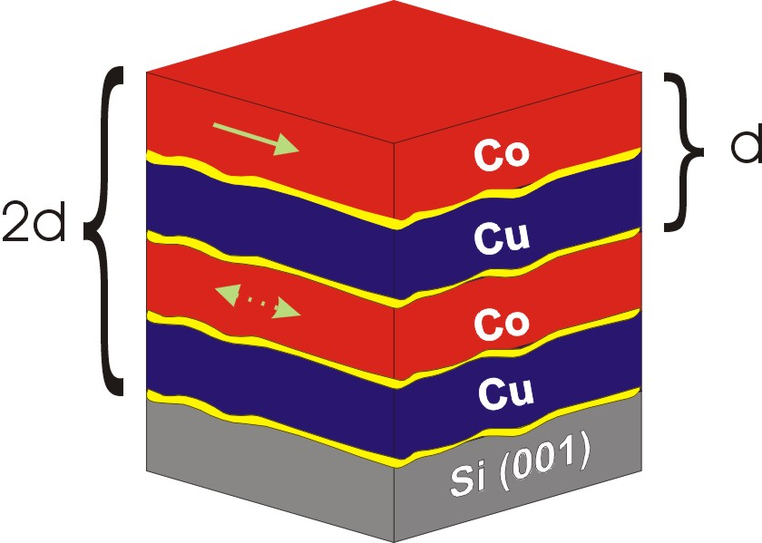
Some early examples
Ni L₃ Edge ± H_{sat}
Anti-Ferromagnetic ML

Slide 14
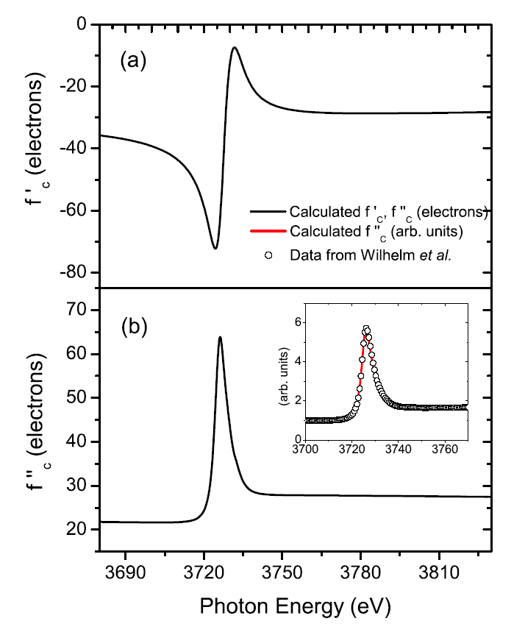
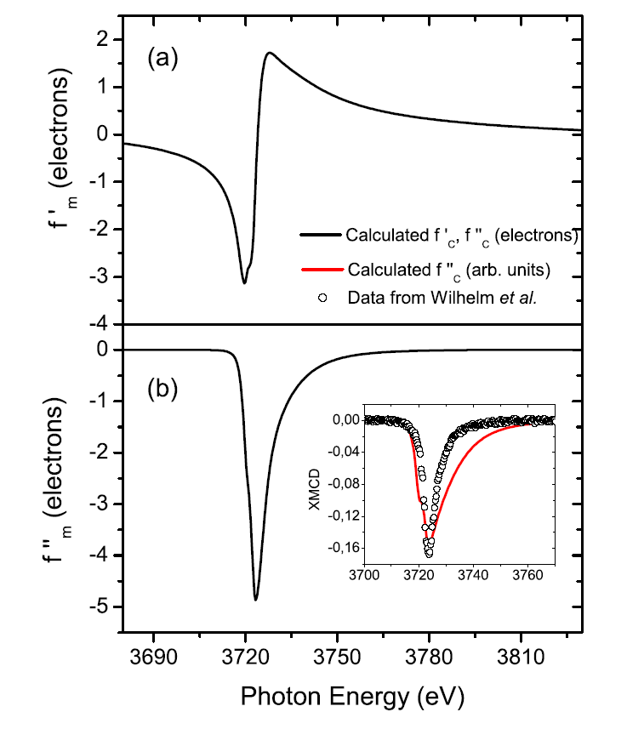
Optical Constants
Refractive index now a function of density, composition and magnetic moment.
Charge Terms
Magnetic Terms
The biggest problem is that the resonant terms F⁽⁰⁾ and F⁽¹⁾ are not well known:
Screening effects for non K edge state become important in the Hartree-Fock calculations leading to ~20% uncertainties
Local chemical environment.
2 possible approaches:
Experimentally determined factors determined from XAS and XMCD
Set moment to 1μ_{B} and fit the real and imaginary terms within F(1) – removes possibility of absolute measurements
XAS + KK
XMCD + KK
S. D. Brown, et al. Phys. Rev. B 77, 014427 (2008)

Slide 15

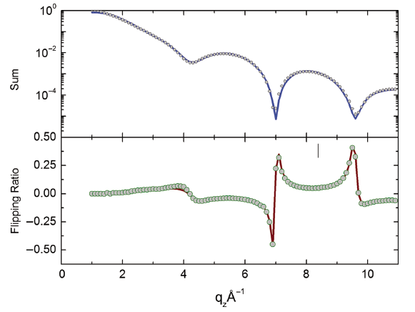
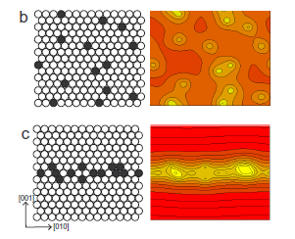
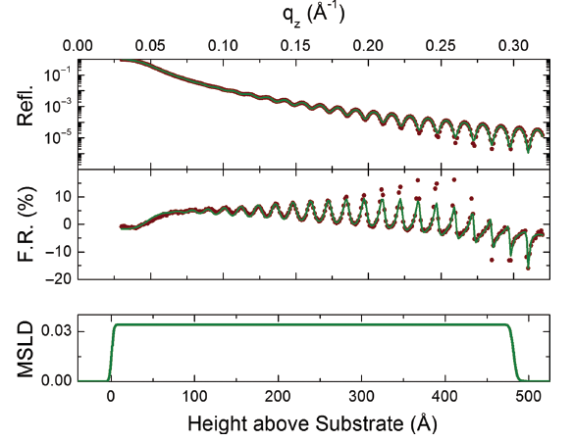

Fe/Pd @ the Pd L₃ Edge
ALLOY: Si/Fe(2nm)/Pd_{x}Fe_{1-x} (40nm)
Q-Well: MgO/V(2nm)/Pd(40nm)/Fe(x)/Pd(2nm)
M. Björck et al. Journal of Surfaces and Interfaces of Materials 2, 24–32 (2014)

Slide 16
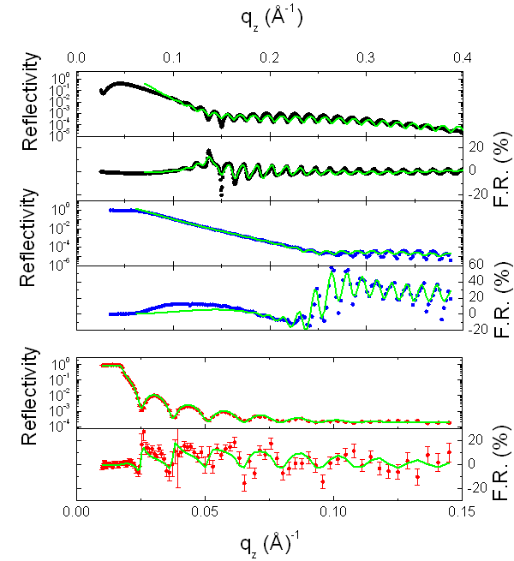
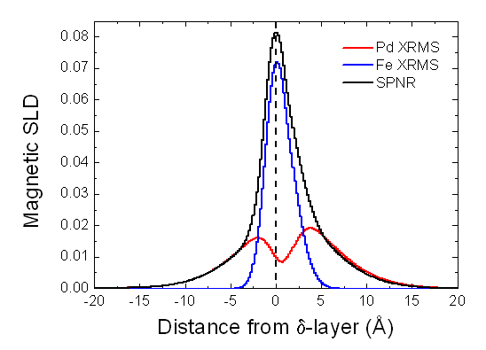
1.4 Monolayer Fe Example
Fe moment close to the interface.
Pd moment extends approx 10 Å from the centre of the Fe layer.
Neutrons and x-rays fit to the same model and allow the “x-ray moments” to be calibrated.

Slide 17
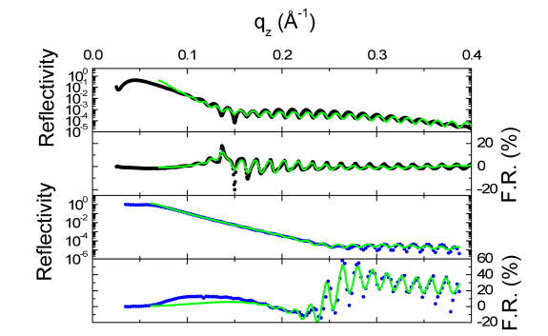
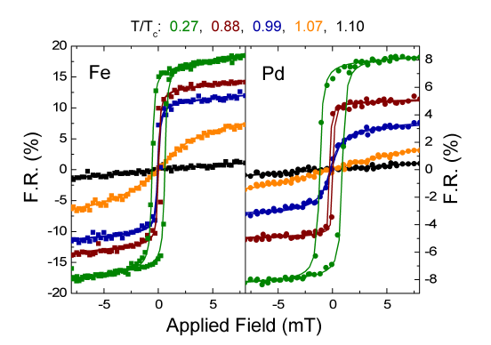
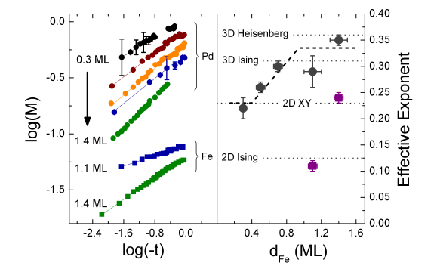
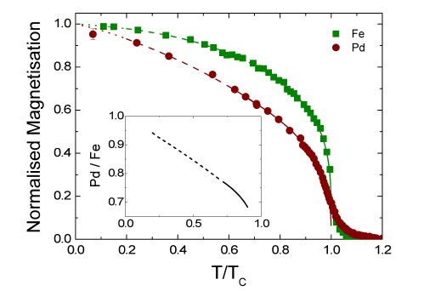
Fe/Pd Element Specific Magnetometry
The temperature dependence of the two magnetic sublattices was followed by conducting hysteresis loops at a fixed q_{z} as a function of temperature.
Effective ordering exponents are obtained for Pd and Fe, with the Pd critical exponent being the superposition of a 2D X-Y ordering and a linear susceptibility of the Fe.
T P A Hase et al . Phys. Rev. B 90, 104403 (2014)

Slide 18
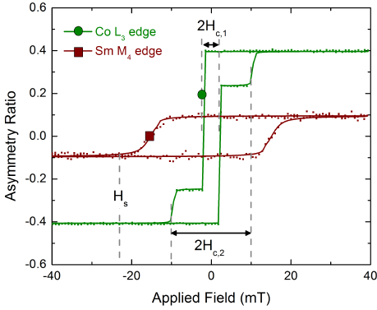
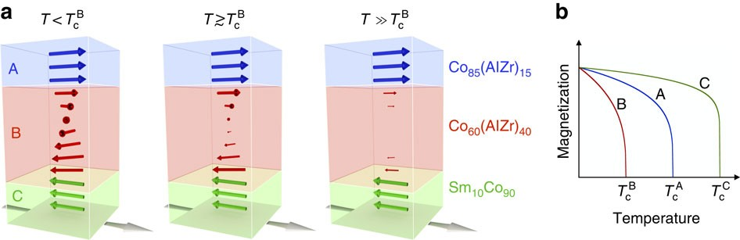
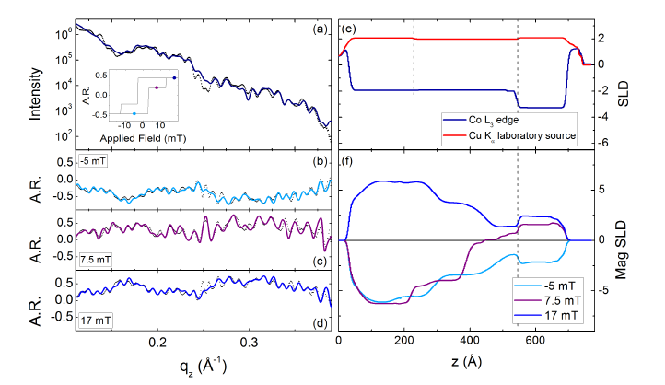
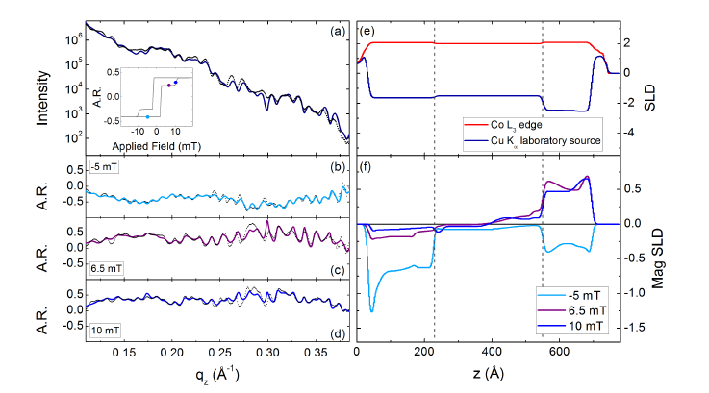
SmCo/Co₆₀AlZr₄₀/Co₈₀AlZr₂₀
100 K
300 K
F Magnus, et al Nature Communications 7, 11931 (2016) and R A Procter et al. ppl. Phys. Lett. 107, 062403(2015)

Slide 19
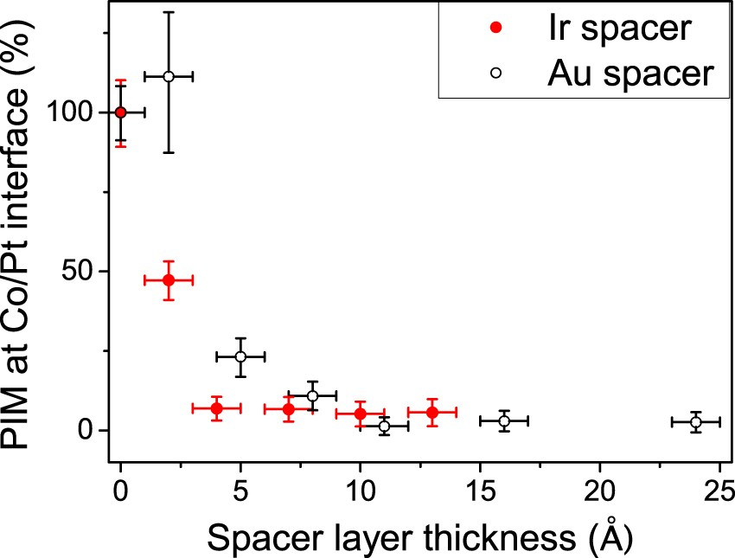
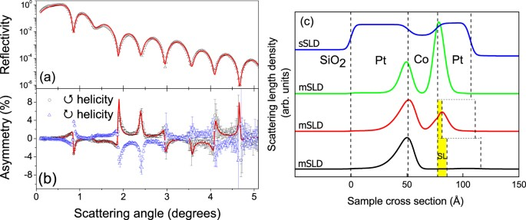
Dzyaloshinskii-Moriya and Proximity
The role of interface proximity and the DMi in spintronics remains somewhat controversial. XRMS allows the element specific proximity to explored and role of heavy noble metals with and without significant spin-orbit effects to quantified.
Here we use the Pt L edge to study the induced proximity magnetisation in a Pt/Co/Pt interface and correlate it with Brillouin light scattering measurements of the DMi as a function of interface metal thickness.
R. M. Rowan-Robinson, et al Scientific Reports 7, 16835 (2017)

Slide 20
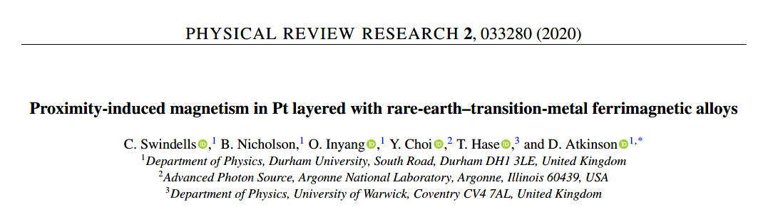
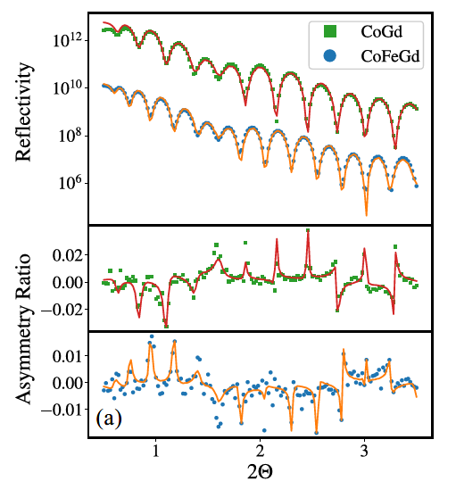
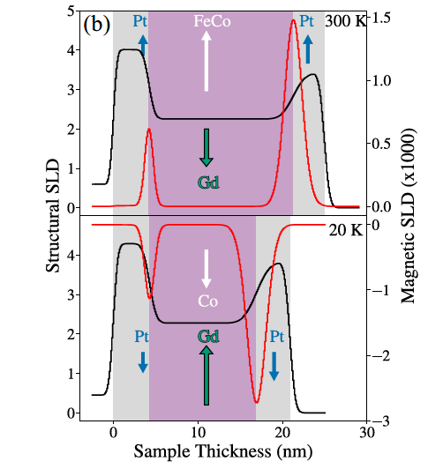
Proximity in Pt/CoGd(Fe)/Pt
Similarly, we also wanted to understand the mechanism driving the induced moment between Pt and ferrimagnetic layers.
The extent of the PIM in Pt, respectively and its direction depends on the structural roughness and composition with direct d-d coupling between the Pt and the transition metals.
C. Swindells et al. Phys. Rev. Research 2 033280 (2020)

Slide 21
Conclusions
Resonant reflectivity exploits the anomalous scattering factors to change the refractive index of the layers.
New, and more robust, structural determination becomes possible through simultaneous fitting of reflectivity scans recorded at different energies and through the combination of XRR and PNR.
Tuning to specific resonances allows the magnetic structure to be probed using electronic dichroic effects to yield both magnetisation and magnetic profile information.
C. Swindells et al. Submitted to

Slide 22
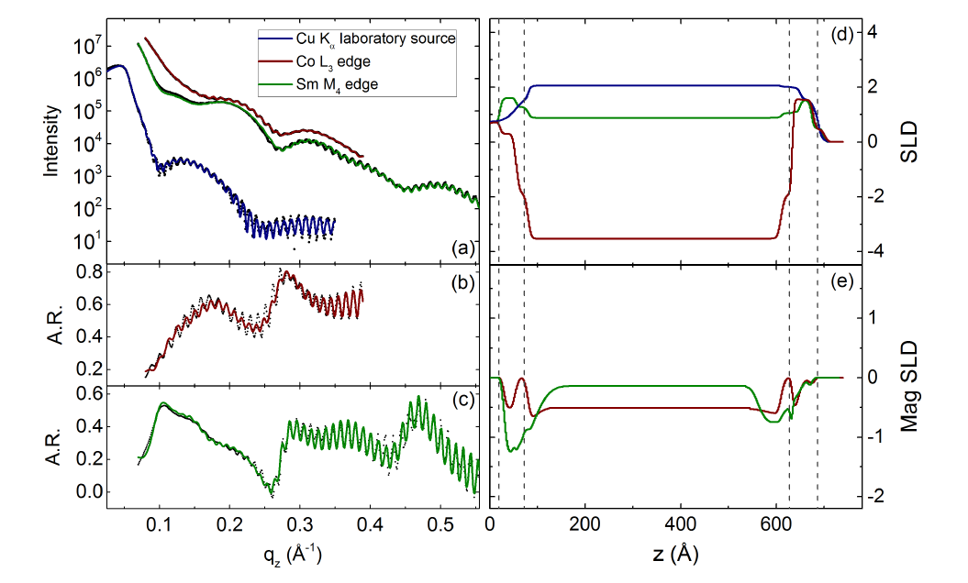
But….
Issue remain in:
Optical constants
Good models of the structural and magnetic interfaces (which may be different)
Simultaneous fitting strategies and the figure of merit to be used
Uncertainties in the x-ray data (not Poisson)
Uncertainties in the SLDs
Model input bias
Si/AlZr/Sm₈Co₉₂/AlZr

